Slide 1


Naive Bayes, K-Means & Hierarchical Clustering
One probability classifier and two ways to find groups, for AI & Robotics
VSP TECHVERSE
An Institute of AI & Robotics
Notes:
Welcome. Today we learn three new models. Naive Bayes is a supervised classifier based on probability. K-Means and hierarchical clustering are unsupervised: they find groups in data without any labels. As always, every example uses robot data.

Slide 2
TODAY
Where Today's Models Fit
Machine Learning
Supervised (has answers)
Unsupervised (no answers)
Classification
Clustering
Naive Bayes
K-Means
Hierarchical
Part 1 Naive Bayes
predict a category using probability
Part 2 K-Means
split data into k groups
Part 3 Hierarchical
build a family tree of groups
Notes:
Here is where today's models fit. Naive Bayes is supervised: it learns from labelled examples and predicts a category, like faulty or ok. K-Means and hierarchical clustering are unsupervised: there are no answers in the data, and they discover groups by themselves.

Slide 3
PART 1
Naive Bayes
Predicting with probability
Probability and Bayes' theorem
Why it is called "naive"
Gaussian and Multinomial Naive Bayes in code
Notes:
Part one: Naive Bayes. It is a simple, fast classifier that uses probability to decide which class is most likely.

Slide 4

NAIVE BAYES
The Idea: Update Your Guess with Evidence
Before (prior)
Evidence
After (posterior)
20%
☁
70%
It rains on 20% of days.
You see dark clouds in the sky.
Rain is now much more likely.
Naive Bayes does exactly this: it starts with how common each class is, then updates the chance using what it sees in the data.
ROBOTICS EXAMPLE Most robots are fine (prior), but this one is hot and vibrating (evidence), so it is probably faulty (posterior).
Notes:
The idea behind Naive Bayes is something we do every day. Before looking outside, you know it rains on about 20 percent of days: that is the prior. Then you see dark clouds: that is evidence. Now you think rain is much more likely: that is the posterior. Naive Bayes does the same with data. For our robots: most are fine, but if one is hot and vibrating, it is probably faulty.

Slide 5
NAIVE BAYES
Probability Basics with 10 Robots
P(faulty) = 4 / 10 = 0.4
chance a robot is faulty
faulty · noisy
faulty · noisy
faulty · noisy
ok · noisy
ok
P(noisy | faulty) = 3 / 4 = 0.75
chance of noise, IF it is faulty
ok
ok
ok
ok
faulty
P(noisy | ok) = 1 / 6 ≈ 0.17
chance of noise, IF it is ok
● faulty (4) ● ok (6) noisy = makes a strange sound
The bar | means "given" or "if we know". P(noisy | faulty) = chance of noise when we already know the robot is faulty.
KEY IDEA Counting is all you need: probabilities come straight from the data.
Notes:
Let us count with 10 robots. 4 are faulty, so the probability of faulty is 4 out of 10, 0.4. 3 of the 4 faulty robots are noisy, so the probability of noisy given faulty is 0.75. Only 1 of the 6 ok robots is noisy, so the probability of noisy given ok is about 0.17. The vertical bar means given: we already know the second part.

Slide 6
NAIVE BAYES
Bayes' Theorem
BAYES' THEOREM
WORKED EXAMPLE: A FAULT ALARM
P(A | B) = P(B | A) × P(A) / P(B)
5% of robots are faulty
The alarm catches 90% of faulty robots
It also falsely rings for 10% of ok robots
The alarm rings. Is the robot really faulty?
Faulty and alarm: 0.05 × 0.90 = 0.045
Ok and alarm: 0.95 × 0.10 = 0.095
P(faulty | alarm) = 0.045 / (0.045 + 0.095)
= 0.32 → only 32%!
P(A | B) Posterior: what we want: chance of A after seeing B
P(B | A) Likelihood: how often we see B when A is true
P(A) Prior: how common A is before any evidence
P(B) Evidence: how common B is overall
Notes:
Bayes' theorem tells us how to update a probability. The posterior, the chance of A given B, equals the likelihood times the prior, divided by the evidence. Example: 5 percent of robots are faulty. The alarm catches 90 percent of faulty robots but also rings for 10 percent of healthy ones. If the alarm rings, what is the chance the robot is really faulty? Faulty-and-alarm is 0.045, ok-and-alarm is 0.095, so the answer is 0.045 divided by 0.14: only 32 percent. Because faulty robots are rare, most alarms are false. That surprises most people, and it is why the prior matters.

Slide 7
NAIVE BAYES
Why "Naive"? Combining Several Clues
With many features, Naive Bayes assumes each clue is independent of the others given the class. It is a simplification ("naive"), but it makes the maths easy: just multiply.
score(class) = P(class) × P(clue₁ | class) × P(clue₂ | class) × …
NEW ROBOT: NOISY AND HOT. FAULTY OR OK?
FAULTY
OK
Turn scores into %
0.225 / (0.225 + 0.033)
= 87% faulty
P(faulty) × P(noisy|faulty) × P(hot|faulty)
P(ok) × P(noisy|ok) × P(hot|ok)
0.4 × 0.75 × 0.75
0.6 × 0.17 × 0.33
= 0.225
= 0.033
From our 10 robots: P(hot | faulty) = 3/4 and P(hot | ok) = 2/6. The highest score wins → FAULTY.
Notes:
With several clues, Naive Bayes multiplies their probabilities. It assumes the clues are independent within each class, which is rarely perfectly true, so we call it naive, but it works surprisingly well. A new robot is noisy and hot. Score for faulty: 0.4 times 0.75 times 0.75, which is 0.225. Score for ok: 0.6 times 0.17 times 0.33, about 0.033. The faulty score is much higher. Dividing by the total gives 87 percent faulty.

Slide 8



NAIVE BAYES
3 Types of Naive Bayes
Gaussian NB
Multinomial NB
Bernoulli NB
Numbers (measurements)
Counts (how many times)
Yes / No (0 or 1)
Assumes each feature follows a bell curve in each class.
Uses word or event counts. Great for text.
Uses whether a feature is present or not.
ROBOT EXAMPLE
ROBOT EXAMPLE
ROBOT EXAMPLE
Temperature, vibration, distance
Robot voice commands, spam filter
Door open? Light on? Object seen?
GaussianNB()
MultinomialNB()
BernoulliNB()
Notes:
There are three common types of Naive Bayes. Gaussian Naive Bayes is for numbers, like temperature, and assumes a bell curve. Multinomial Naive Bayes is for counts, like how many times each word appears, which makes it great for text such as voice commands. Bernoulli Naive Bayes is for yes or no features. Today we code Gaussian and Multinomial.

Slide 9
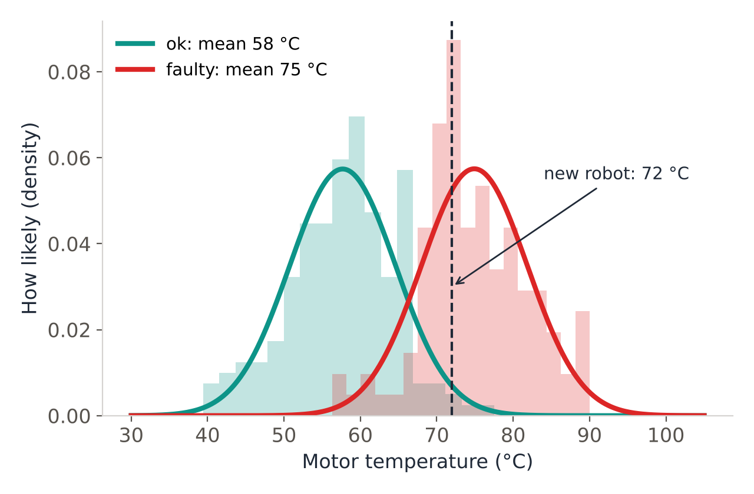
NAIVE BAYES
Gaussian Naive Bayes: Bell Curves
For numbers, the model learns the average and spread of each feature for each class, and draws a bell curve. For a new reading it checks which curve is higher.
ok robots: average 58 °C
faulty robots: average 75 °C
New robot at 72 °C: the red (faulty) curve is higher
It does the same for vibration, then multiplies
ROBOTICS EXAMPLE Training is just computing a mean and spread per class, so it is extremely fast, even on a small robot computer.
Notes:
Gaussian Naive Bayes handles numbers. For each class it learns the average and the spread of each feature and draws a bell curve. ok robots average 58 degrees, faulty ones 75. For a new robot at 72 degrees, the faulty curve is higher, so temperature points to faulty. The model does the same for vibration and multiplies the results. Training is just computing averages, so it is extremely fast.

Slide 10




DATA
Today's Robot Datasets
Gaussian NB
Multinomial NB
K-Means
Hierarchical
robot_fault_data.csv
robot_voice_commands.csv
robot_delivery_points.csv
robot_profiles.csv
300 rows
160 commands
240 points
24 robots
INPUTS
INPUTS
INPUTS
INPUTS
motor_temp_c, vibration_mm_s
command (text)
x_m, y_m (drop-off spots)
avg_speed_mps, power_w
ANSWER
ANSWER
ANSWER
ANSWER
status: ok / faulty
action: move / turn / stop / grab
no labels
no labels
Notes:
We use four generated robot datasets. Fault data with temperature and vibration for Gaussian Naive Bayes. Voice commands for Multinomial Naive Bayes. Delivery drop-off points for K-Means. And robot profiles of speed and power for hierarchical clustering. Notice the last two have no answer column: that is unsupervised learning.

Slide 11
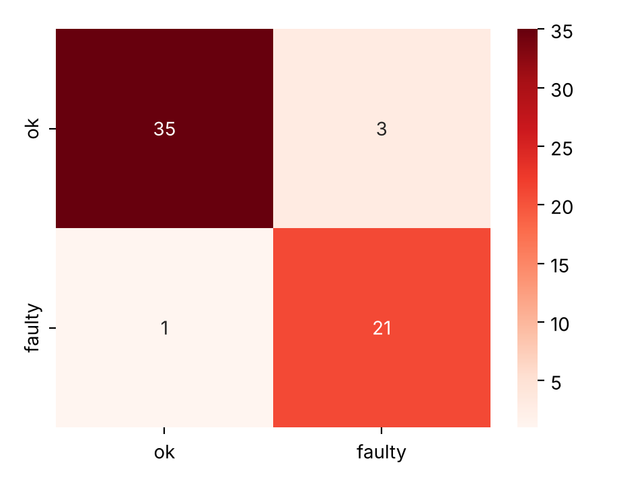
NAIVE BAYES
Code: Gaussian Naive Bayes
gaussian_nb.py
CONFUSION MATRIX (TEST DATA)
import pandas as pd
import seaborn as sns
import matplotlib.pyplot as plt
from sklearn.model_selection import train_test_split
from sklearn.naive_bayes import GaussianNB
from sklearn import metrics
# 1. Load the robot data
df = pd.read_csv("robot_fault_data.csv")
# 2. Inputs (X) and the answer (y)
X = df[["motor_temp_c", "vibration_mm_s"]]
y = df["status"]
# 3. Keep 20% of the rows for testing
X_train, X_test, y_train, y_test = train_test_split(
X, y, test_size=0.2, random_state=42)
# 4. Train Gaussian Naive Bayes
model = GaussianNB()
model.fit(X_train, y_train)
# 5. Predict and check
y_pred = model.predict(X_test)
print("Accuracy:", round(metrics.accuracy_score(y_test, y_pred), 2))
# 6. Probabilities for a new robot: 72 °C, 4.0 mm/s
new = pd.DataFrame({"motor_temp_c": [72], "vibration_mm_s": [4.0]})
print(model.classes_, model.predict_proba(new).round(3))
# 7. Confusion matrix
labels = ["ok", "faulty"]
cm = metrics.confusion_matrix(y_test, y_pred, labels=labels)
sns.heatmap(cm, annot=True, cmap="Reds",
xticklabels=labels, yticklabels=labels)
plt.show()
OUTPUT
Accuracy: 0.93
['faulty' 'ok'] [[0.938 0.062]]
Accuracy 0.93. The new robot (72 °C, 4.0 mm/s) is 93.8% likely to be faulty: Naive Bayes gives probabilities, not just labels.
Notes:
We follow our usual steps: load, choose X and y, split 80/20, train GaussianNB, predict and check. Accuracy on the 60 test robots is 0.93. predict_proba gives the probability of each class: a new robot at 72 degrees and 4.0 mm/s is 93.8 percent likely to be faulty. The confusion matrix shows only 4 mistakes.

Slide 12
NAIVE BAYES
Turning Words into Numbers: Bag of Words
A model cannot read words. CountVectorizer builds a vocabulary and counts how many times each word appears in each command.
command | go | left | stop | turn | the | box | grab | … | action
"go forward" | 1 | 0 | 0 | 0 | 0 | 0 | 0 | … | move
"turn left" | 0 | 1 | 0 | 1 | 0 | 0 | 0 | … | turn
"stop now" | 0 | 0 | 1 | 0 | 0 | 0 | 0 | … | stop
"grab the box" | 0 | 0 | 0 | 0 | 1 | 1 | 1 | … | grab
Then Naive Bayes learns: words like "stop", "halt", "freeze" appear a lot in stop commands, so they give a high P(word | stop).
ROBOTICS EXAMPLE This is how simple voice assistants and chatbots sort a command into an intent.
Notes:
Computers cannot read words, so we turn text into numbers. CountVectorizer collects every word into a vocabulary, then counts how many times each word appears in each command. "Turn left" has a 1 under turn and left, and 0 elsewhere. Multinomial Naive Bayes then learns which words are common in each action: stop, halt and freeze for stop commands, for example.

Slide 13
NAIVE BAYES
Code: Voice Commands (Multinomial NB)
voice_commands.py
OUTPUT
import pandas as pd
from sklearn.model_selection import train_test_split
from sklearn.feature_extraction.text import CountVectorizer
from sklearn.naive_bayes import MultinomialNB
from sklearn import metrics
# 1. Load the voice commands
df = pd.read_csv("robot_voice_commands.csv")
X_train, X_test, y_train, y_test = train_test_split(
df["command"], df["action"], test_size=0.2, random_state=42)
# 2. Turn words into counts (bag of words)
vec = CountVectorizer()
X_train_counts = vec.fit_transform(X_train)
X_test_counts = vec.transform(X_test)
# 3. Train Multinomial Naive Bayes
model = MultinomialNB()
model.fit(X_train_counts, y_train)
# 4. Check on the test commands
y_pred = model.predict(X_test_counts)
print("Accuracy:", round(metrics.accuracy_score(y_test, y_pred), 2))
# 5. Try brand-new commands
new = ["please stop now", "pick up the red box",
"go ahead slowly", "rotate to the right"]
for c, p in zip(new, model.predict(vec.transform(new))):
print(f"{c:22} -> {p}")
Accuracy: 1.0
please stop now -> stop
pick up the red box -> grab
go ahead slowly -> move
rotate to the right -> turn
CountVectorizer: words → counts
fit_transform: learn the vocabulary from training text
transform: reuse the same vocabulary for new text
Result: all 4 brand-new commands understood
Notes:
Here is the full voice command example. We load 160 commands with their actions and split them. CountVectorizer turns words into counts: fit_transform learns the vocabulary from the training commands, transform reuses it for the test commands. MultinomialNB trains in an instant and gets every test command right. Then we try four brand-new sentences, and the robot understands all of them: stop, grab, move and turn.

Slide 14


NAIVE BAYES
Naive Bayes: Good & Bad
ADVANTAGES
DISADVANTAGES
Very fast to train and predict
Works well with small datasets
Gives probabilities, not just labels
Excellent for text (commands, spam, reviews)
Assumes features are independent (rarely true)
Probabilities can be over-confident
Gaussian NB assumes bell-shaped data
Usually beaten by stronger models on complex data
BEST FIT IN ROBOTICS Quick, lightweight decisions on a small robot computer: voice commands, simple fault alerts.
Notes:
Naive Bayes is fast, works on small data, gives probabilities and is excellent for text. But it assumes independent features, its probabilities can be over-confident, and more powerful models often do better on complex problems.

Slide 15
PART 2
K-Means Clustering
Finding k groups in data with no labels
What is clustering?
The 4 steps of K-Means
Choosing k: elbow method and silhouette score
Notes:
Part two: K-Means clustering. Now there are no answers in the data. The algorithm has to discover the groups by itself.

Slide 16
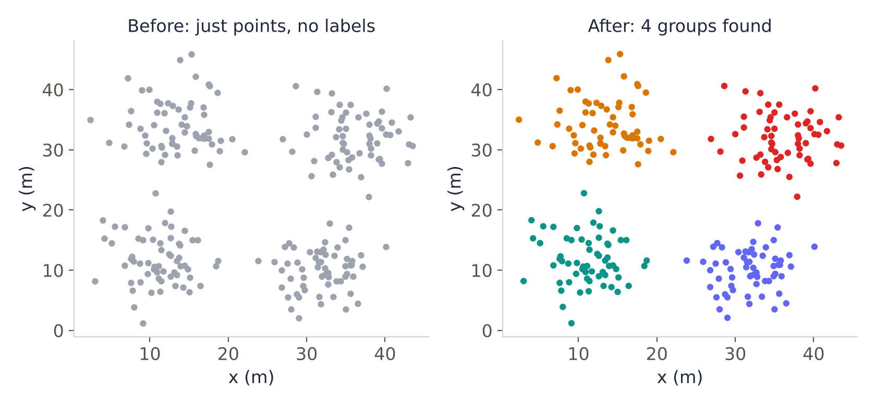

K-MEANS CLUSTERING
What is Clustering?
Clustering puts similar items into the same group, without being told what the groups are. It is unsupervised learning.
Everyday example
Sorting laundry into whites, colours and darks, without labels on the clothes.
Supervised: we give answers. Clustering: no answers, the model finds the groups.
ROBOTICS EXAMPLE 240 delivery drop-offs in a warehouse: where should we place 4 charging hubs for the robots?
Notes:
Clustering means putting similar things into the same group without being told the groups, like sorting laundry by colour. On the left are 240 delivery drop-off points in a warehouse, with no labels. On the right, the algorithm found four natural groups. That tells us where to put four charging hubs for our delivery robots.

Slide 17
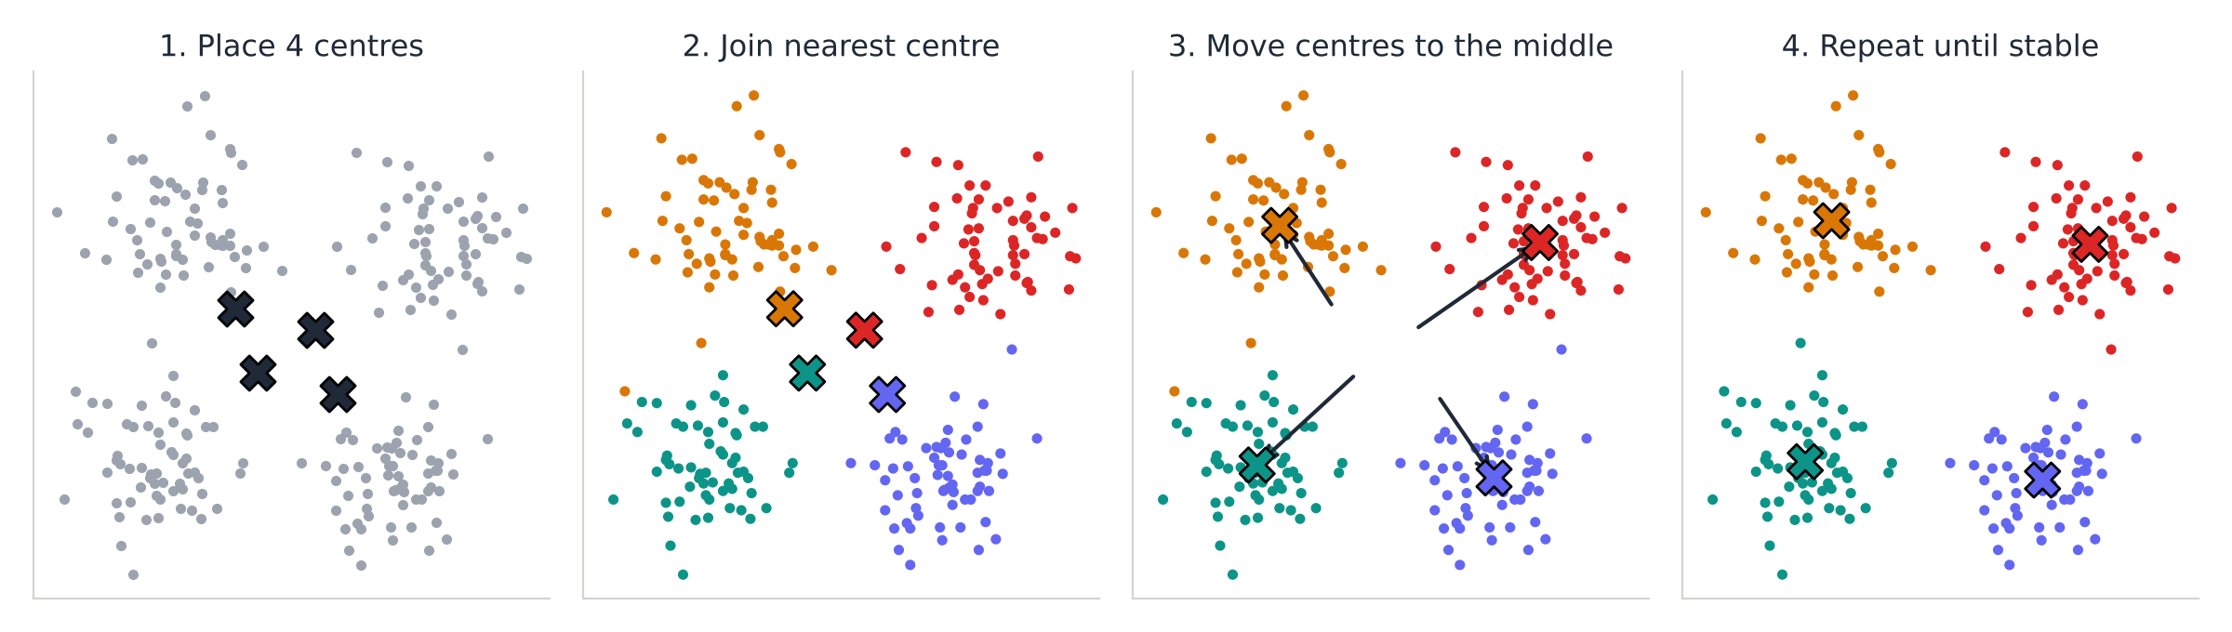
K-MEANS CLUSTERING
How K-Means Works: 4 Steps
Choose k and place k centres (randomly)
Each point joins its nearest centre
Move each centre to the middle (mean) of its points
Repeat 2 and 3 until the centres stop moving
1
2
3
4
The "means" in K-Means: each centre is the average (mean) position of its group.
Notes:
K-Means has four steps. First, choose k, the number of groups, and place k centres, often at random. Second, every point joins its nearest centre. Third, each centre moves to the average position of its points. Fourth, repeat steps two and three until the centres stop moving. That average, the mean, is where the name K-Means comes from.

Slide 18
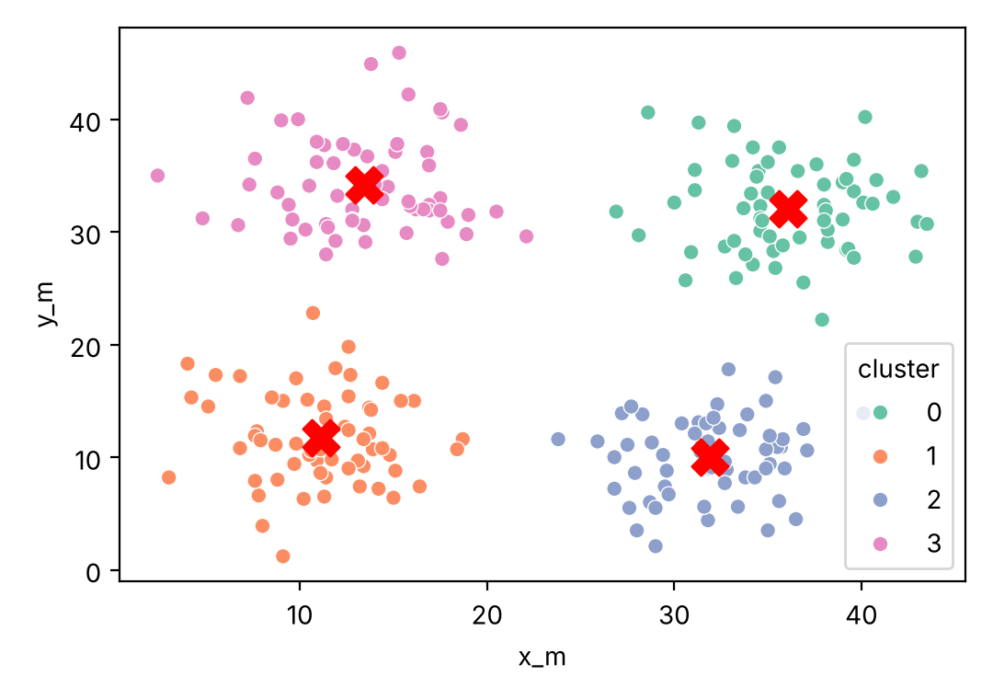
K-MEANS CLUSTERING
Code: Placing 4 Charging Hubs
kmeans.py
CLUSTERS AND THEIR CENTRES
import pandas as pd
import seaborn as sns
import matplotlib.pyplot as plt
from sklearn.cluster import KMeans
# 1. Load delivery drop-off points (no labels!)
df = pd.read_csv("robot_delivery_points.csv")
X = df[["x_m", "y_m"]]
# 2. Ask K-Means for 4 groups
model = KMeans(n_clusters=4, n_init=10, random_state=42)
df["cluster"] = model.fit_predict(X)
# 3. Cluster centres = best spots for 4 charging hubs
centres = pd.DataFrame(model.cluster_centers_, columns=["x_m", "y_m"])
print(centres.round(1))
print("Points per cluster:",
df["cluster"].value_counts().sort_index().tolist())
# 4. Plot the groups and their centres
sns.scatterplot(data=df, x="x_m", y="y_m", hue="cluster",
palette="Set2")
plt.scatter(centres["x_m"], centres["y_m"], c="red",
marker="X", s=200)
plt.show()
OUTPUT
x_m y_m
0 36.1 32.0
1 11.1 11.7
2 31.9 10.0
3 13.4 34.2
Points per cluster: [60, 60, 60, 60]
The red X centres are the best spots for charging hubs: each is closest to its 60 drop-off points.
Notes:
We load the drop-off points. There is no y: no answers. KMeans with n_clusters equal to 4 finds four groups, and fit_predict gives each point its cluster number. The cluster centres are the best places for four charging hubs, and each cluster has 60 points. The red crosses on the plot are the centres.

Slide 19
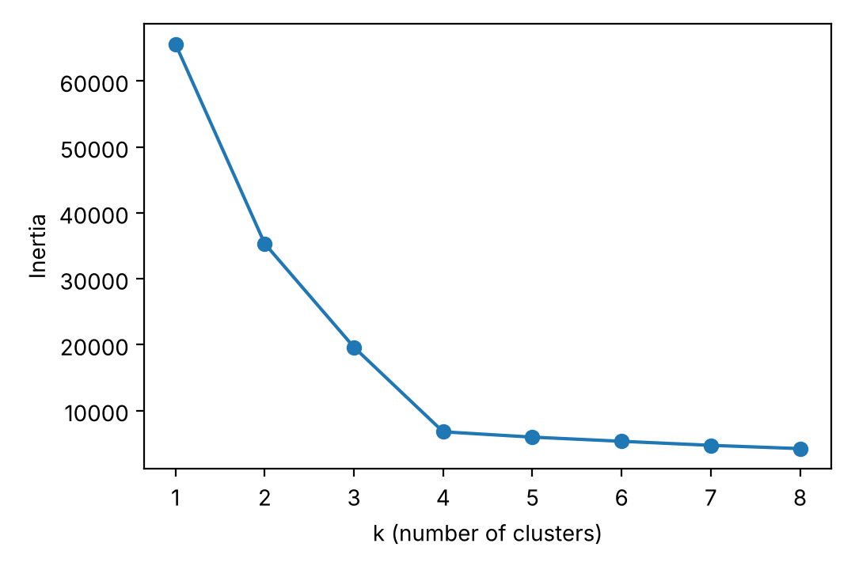
K-MEANS CLUSTERING
How Many Clusters? Choosing k
choose_k.py
ELBOW METHOD
from sklearn.metrics import silhouette_score
# Elbow method: try k = 1 to 8
inertia = []
for k in range(1, 9):
km = KMeans(n_clusters=k, n_init=10, random_state=42).fit(X)
inertia.append(km.inertia_)
plt.plot(range(1, 9), inertia, marker="o")
plt.xlabel("k (number of clusters)"); plt.ylabel("Inertia")
plt.show()
# Silhouette score: higher is better (max 1)
for k in range(2, 7):
labels = KMeans(n_clusters=k, n_init=10,
random_state=42).fit_predict(X)
print(k, round(silhouette_score(X, labels), 3))
OUTPUT
2 0.459
3 0.527
4 0.663
5 0.586
6 0.516
k | score
Inertia: total distance of points to their centre. Lower = tighter groups.
Elbow: the bend where adding clusters stops helping much → k = 4
Silhouette: how well each point fits its group (−1 to 1). Best at k = 4 (0.663)
Notes:
K-Means needs k in advance, so how do we choose it? The elbow method: train K-Means for k from 1 to 8 and plot inertia, the total distance of points to their centres. It always falls, but it bends sharply at k equals 4, the elbow. The silhouette score checks how well each point fits its own group compared with the next group, from minus 1 to 1. It is highest at k equals 4, 0.663. Both agree: 4 clusters.

Slide 20
K-MEANS CLUSTERING
K-Means: Good & Bad
ADVANTAGES
DISADVANTAGES
Simple and easy to understand
Fast, even on large datasets
Cluster centres are easy to use (e.g. hub locations)
Works well on round, similar-sized groups
You must choose k in advance
Random start can give different results (use n_init)
Struggles with long, odd-shaped or uneven groups
Sensitive to outliers and feature scale
BEST FIT IN ROBOTICS Placing charging hubs, grouping robot routes, splitting a map into work zones for a robot fleet.
Notes:
K-Means is simple, fast and gives useful centres. But you must pick k, results depend on the random start, it struggles with odd-shaped groups and it is sensitive to outliers and scale.

Slide 21
PART 3
Hierarchical Clustering
Building a family tree of groups
Agglomerative vs divisive
Linkage methods
Reading and cutting a dendrogram
Notes:
Part three: hierarchical clustering. Instead of choosing k first, we build a whole tree of groups, from single points up to one big group, and decide where to cut afterwards.

Slide 22
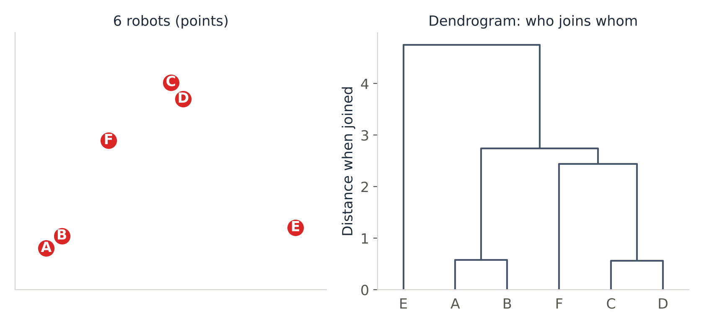
HIERARCHICAL CLUSTERING
What is Hierarchical Clustering?
It builds a tree of clusters, called a dendrogram. Like a family tree: individuals join into families, families into larger families.
Agglomerative (bottom-up)
Start: every point is its own cluster. Repeatedly merge the two closest clusters until only one is left.
MOST COMMON · used today
Divisive (top-down)
Start: all points in one cluster. Repeatedly split a cluster into two until every point is alone.
A+B and C+D join first (closest pairs), then F joins C-D, then everything joins E.
less common
KEY IDEA No need to choose k first: build the tree, then decide how many groups you want.
Notes:
Hierarchical clustering builds a tree of clusters called a dendrogram. The common way is agglomerative, bottom-up: every point starts alone, and we keep merging the two closest clusters until only one remains. Divisive goes top-down and is less common. In the small example, A and B join first, and so do C and D, because they are closest. Then F joins C and D, and finally everything joins E, which is far away. The height of each join shows the distance.

Slide 23
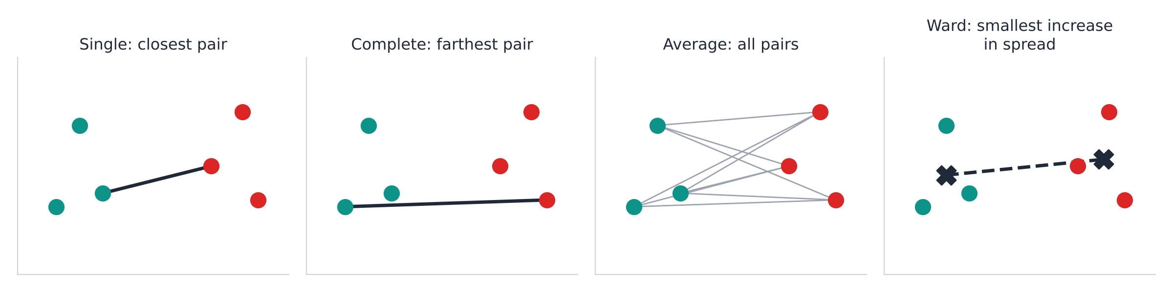
HIERARCHICAL CLUSTERING
Linkage: Distance Between Groups
To merge clusters we must measure how far apart two groups are. The linkage method decides how.
linkage="single"
closest pair
can make long chain-like clusters
linkage="complete"
farthest pair
compact, similar-sized clusters
linkage="average"
average of all pairs
a balance of the two
linkage="ward"
smallest growth in spread
default; tidy, round clusters
Notes:
To merge clusters we must measure the distance between two groups, and there are several ways, called linkage. Single linkage uses the closest pair of points; it can create long chains. Complete linkage uses the farthest pair, giving compact clusters. Average linkage uses the average of all pairs. Ward linkage merges the pair that increases the spread the least; it is the default in scikit-learn and usually gives tidy, round clusters.

Slide 24
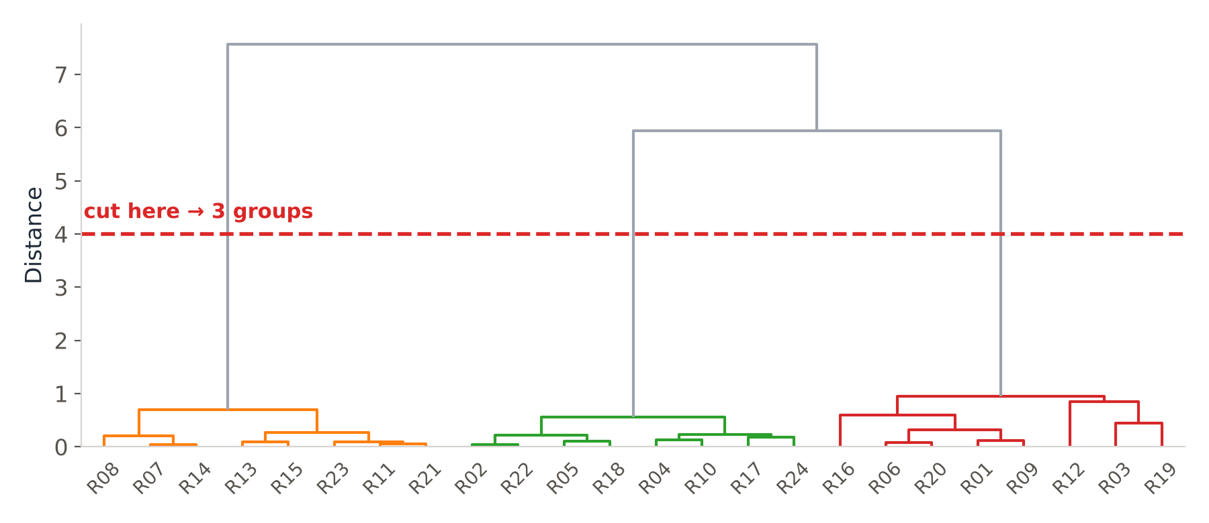
HIERARCHICAL CLUSTERING
Reading and Cutting a Dendrogram
Bottom: each robot alone
Each join = two clusters merging
Height = how different they were
A long vertical gap = very different groups
Draw a horizontal line: the number of lines it crosses = number of clusters
HOW TO CUT Cutting at distance 4 crosses 3 lines → 3 robot types. Cutting lower (e.g. at 0.8) would give more, smaller groups.
Notes:
Read a dendrogram from the bottom up. At the bottom, each robot is alone. Every horizontal join is two clusters merging, and its height shows how different they were. Long vertical gaps mean very different groups. To choose the number of clusters, draw a horizontal line: the number of vertical lines it crosses is the number of clusters. Cutting at distance 4 gives 3 groups of robots.

Slide 25
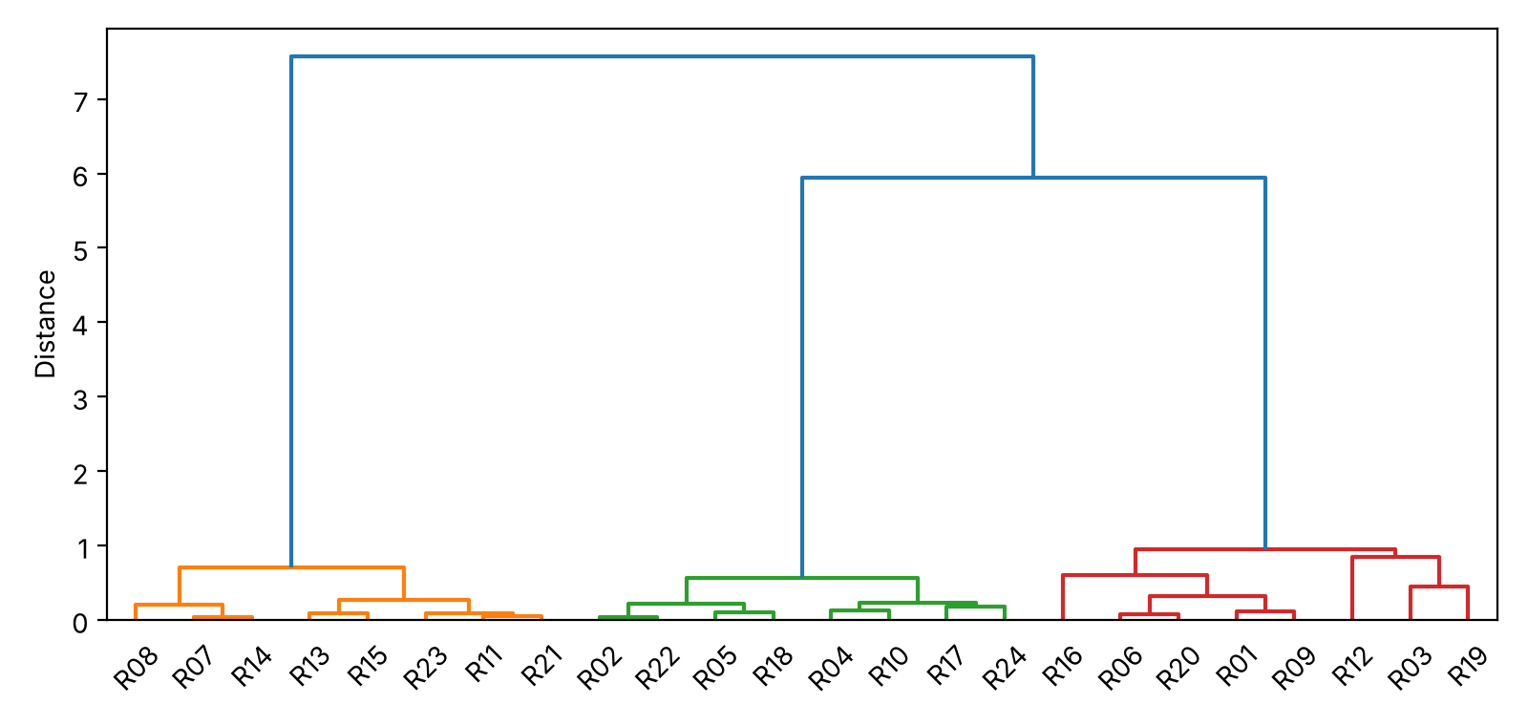
HIERARCHICAL CLUSTERING
Code: Grouping 24 Robots by Behaviour
hierarchical.py
DENDROGRAM
import pandas as pd
import matplotlib.pyplot as plt
from scipy.cluster.hierarchy import linkage, dendrogram
from sklearn.preprocessing import StandardScaler
from sklearn.cluster import AgglomerativeClustering
# 1. Load 24 robot profiles and scale the features
df = pd.read_csv("robot_profiles.csv")
X = StandardScaler().fit_transform(df[["avg_speed_mps", "power_w"]])
# 2. Build the tree with Ward linkage and draw it
Z = linkage(X, method="ward")
dendrogram(Z, labels=df["robot_id"].tolist())
plt.ylabel("Distance")
plt.show()
# 3. Cut the tree into 3 groups
model = AgglomerativeClustering(n_clusters=3, linkage="ward")
df["group"] = model.fit_predict(X)
print(df.groupby("group")[["avg_speed_mps", "power_w"]]
.mean().round(1))
print("Robots per group:",
df["group"].value_counts().sort_index().tolist())
OUTPUT
avg_speed_mps power_w
group
0 4.9 595.6
1 0.4 903.9
2 1.5 291.9
Robots per group: [8, 8, 8]
Three robot types found with no labels: fast movers (4.9 m/s), slow heavy lifters (0.4 m/s, 904 W) and delivery rovers (1.5 m/s, 292 W).
Notes:
We scale speed and power so both count equally. linkage with Ward builds the tree and dendrogram draws it. AgglomerativeClustering with 3 clusters cuts the tree. The group averages reveal three robot types: fast movers, slow heavy lifters using about 900 watts, and delivery rovers at 1.5 metres per second. Each group has 8 robots.

Slide 26
HIERARCHICAL CLUSTERING
Hierarchical Clustering: Good & Bad
ADVANTAGES
DISADVANTAGES
No need to choose k in advance
The dendrogram shows how groups relate
Works with different linkage methods
Good for small, explainable datasets
Slow on large datasets (compares every pair)
Merges cannot be undone later
Results change with the linkage choice
Sensitive to noise, outliers and scaling
BEST FIT IN ROBOTICS Grouping a fleet of robots by behaviour, organising sensor types, building a "family tree" of fault patterns.
Notes:
Hierarchical clustering does not need k in advance and its dendrogram shows how groups relate. But it is slow on big data, merges cannot be undone, results depend on the linkage, and it is sensitive to noise and scaling.

Slide 27
SUMMARY
Naive Bayes vs K-Means vs Hierarchical
 | Naive Bayes | K-Means | Hierarchical
Type | Supervised | Unsupervised | Unsupervised
Task | Classification | Clustering | Clustering
Needs labels? | Yes | No | No
Main idea | Bayes' theorem: probability | Move k centres to group means | Merge closest clusters into a tree
Choose k first? | - | Yes | No: cut the dendrogram
Speed | Very fast | Fast | Slow on big data
Our result | Accuracy 0.93 · voice 1.0 | 4 hubs · silhouette 0.66 | 3 robot types found
Notes:
To sum up: Naive Bayes is a supervised classifier that uses Bayes' theorem and is very fast. K-Means and hierarchical clustering are unsupervised. K-Means needs k first and moves centres to group means; hierarchical builds a tree that you cut afterwards, but it is slower on big data.

Slide 28
REVISION
Key Words to Remember
Prior
How common a class is before seeing evidence
Likelihood
Chance of the evidence if the class is true
Posterior
Updated chance after seeing evidence
Naive assumption
Features are treated as independent
Bag of words
Text turned into word counts
Cluster / centroid
A group / the centre point of a group
Inertia & elbow
Tightness of clusters / bend that suggests k
Silhouette score
How well points fit their cluster (−1 to 1)
Dendrogram
Tree diagram of how clusters merge
Linkage
Rule for distance between two clusters
Notes:
Key words from today: prior, likelihood and posterior from Bayes' theorem, the naive assumption, bag of words, cluster and centroid, inertia and the elbow, silhouette score, dendrogram and linkage. Make sure you can explain each one in your own words.

Slide 29
Thank You
Keep learning, keep building
VSP TECHVERSE
An Institute of AI & Robotics
Notes:
Thank you. Try it yourself: change k in K-Means, try a different linkage in hierarchical clustering, and add your own voice commands to the Naive Bayes example.

